Slide 1
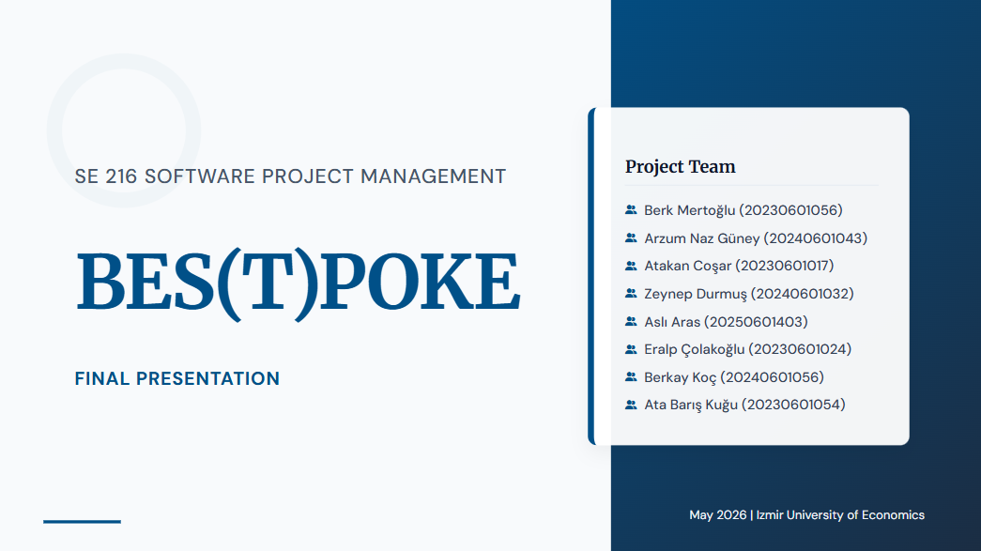

Slide 2
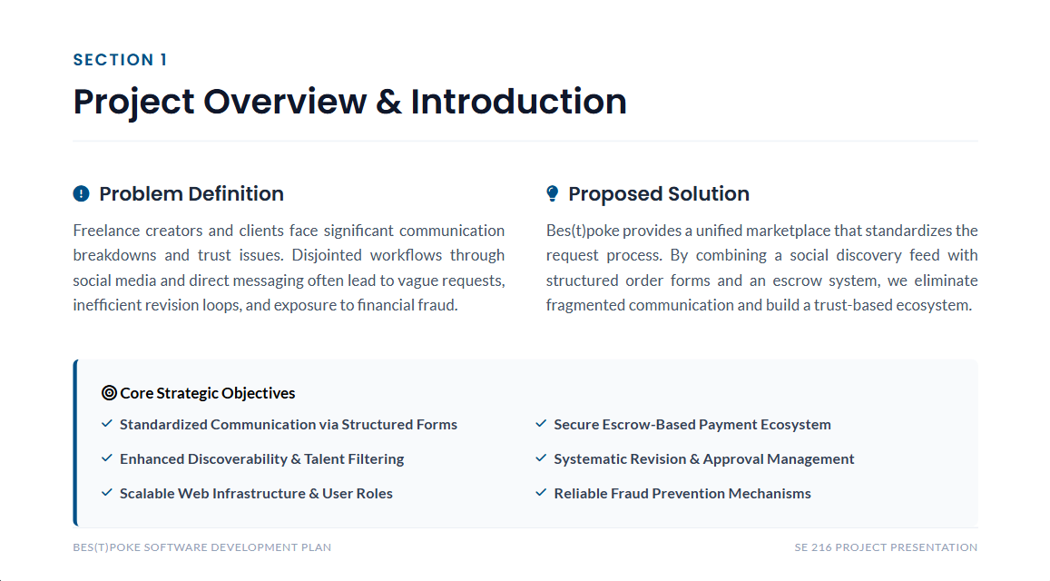

Slide 3


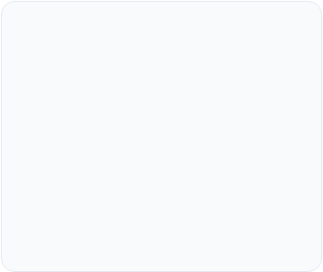
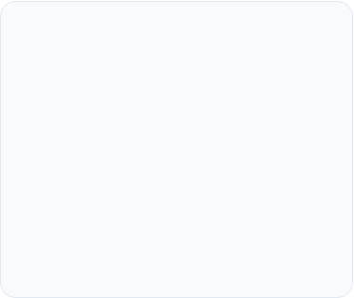



High-Level Functionality
High-Level Functional Requirements (HLFR)
Core Focus
Workflow Mapping
Bes(t)poke Chain
Specific system behaviors based on the strict "What, not How" principle to lock project scope.
Sequential activities with strict guardrails to prevent users from skipping critical project stages.
Strategic path: Registration → Custom Intake → Escrow Capture → Sign-off → Finish.
SYSTEM GUARDRAIL EXAMPLE
"The system blocks the client from the payment stage until the creator’s custom intake form is validated."
3

Slide 4
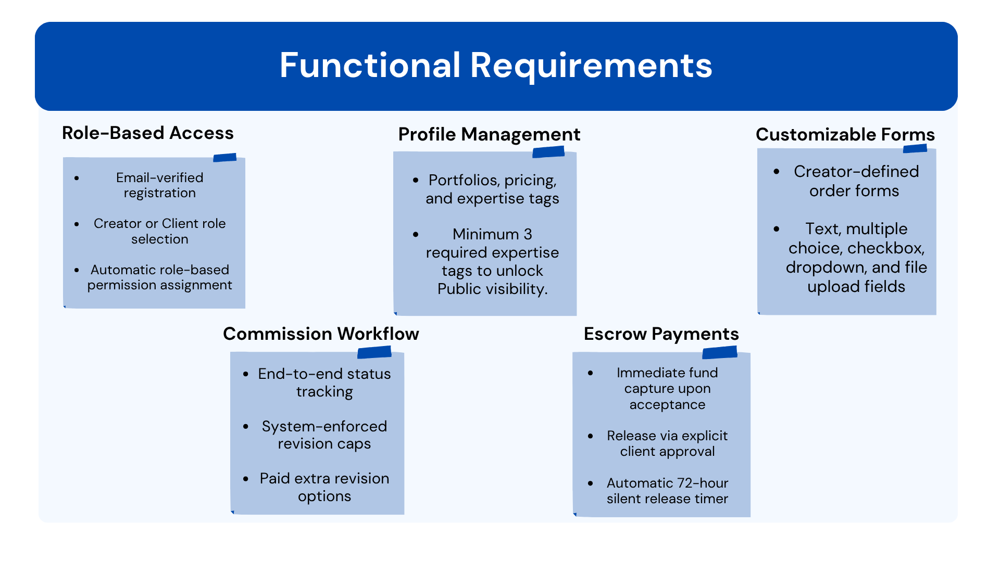

Slide 5
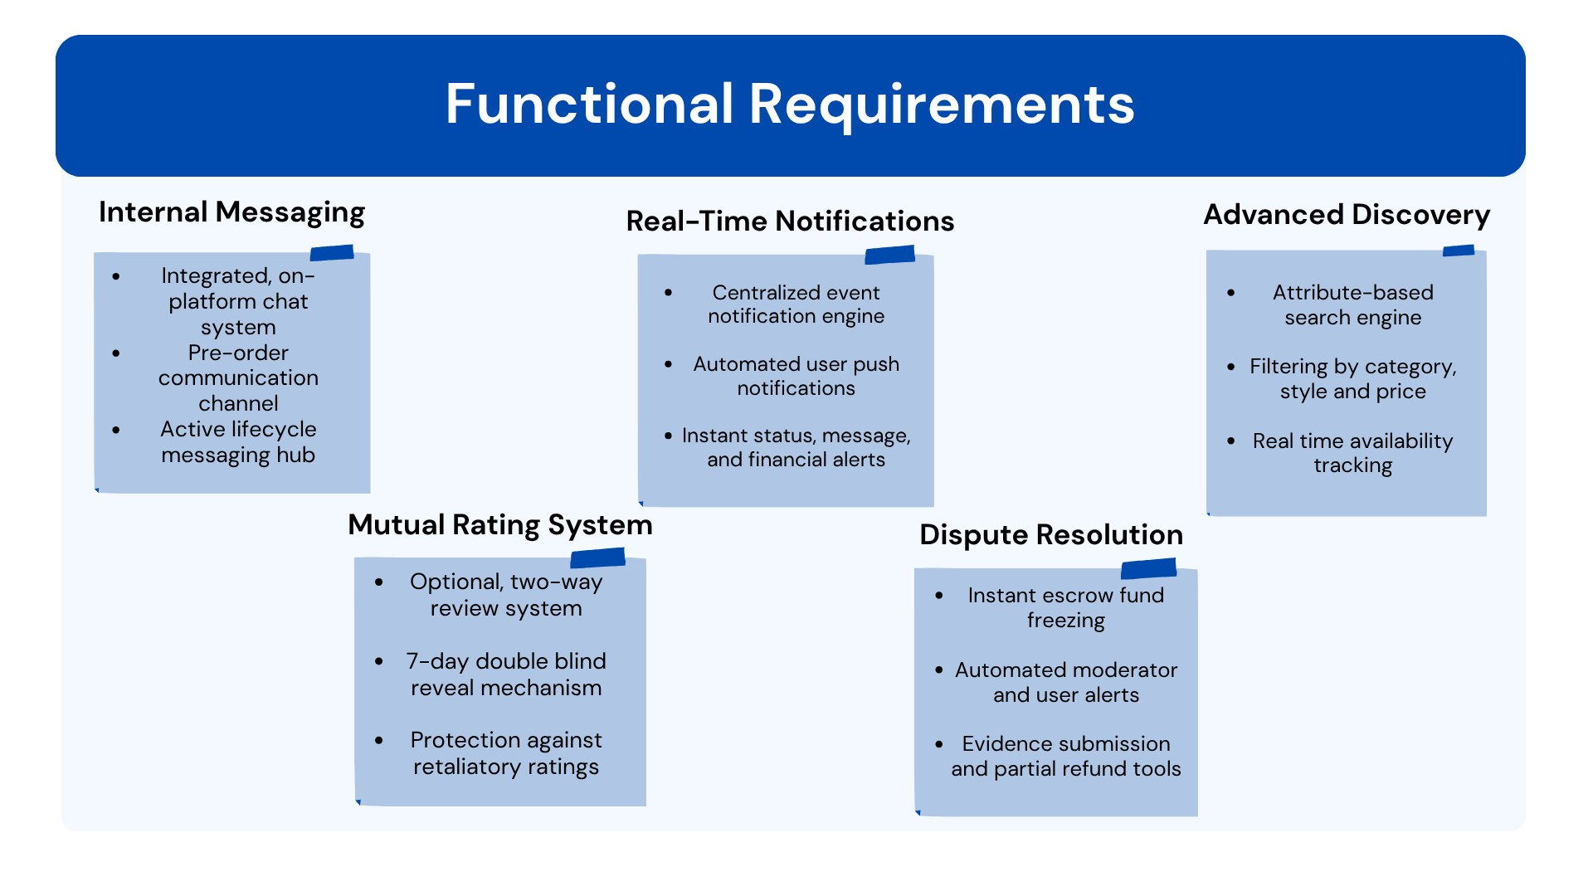

Slide 6
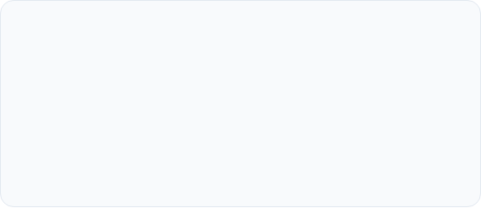
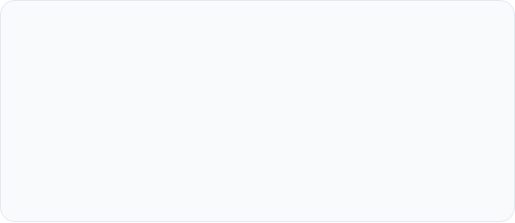

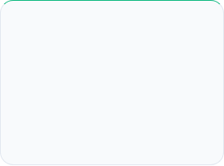
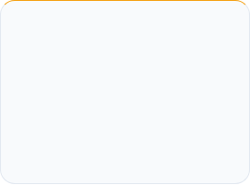
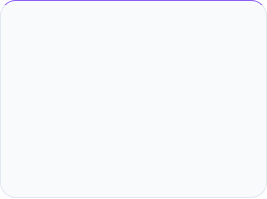
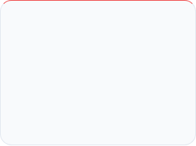



High-Level Non-Functional Requirements (HLNFR)
Non-Functional Attributes
High-Level Scope Locking
Sets the operational benchmarks that guarantee a secure and stable marketplace
Details the global quality requirements before the development team writes a single line of code
Bes(t)poke Quality Pillars
Security
Performance
Usability
Availability
Data encryption & financial compliance.
High-speed queries & low latency.
Intuitive architecture & accessibility.
Maximum uptime & session stability.
6

Slide 7
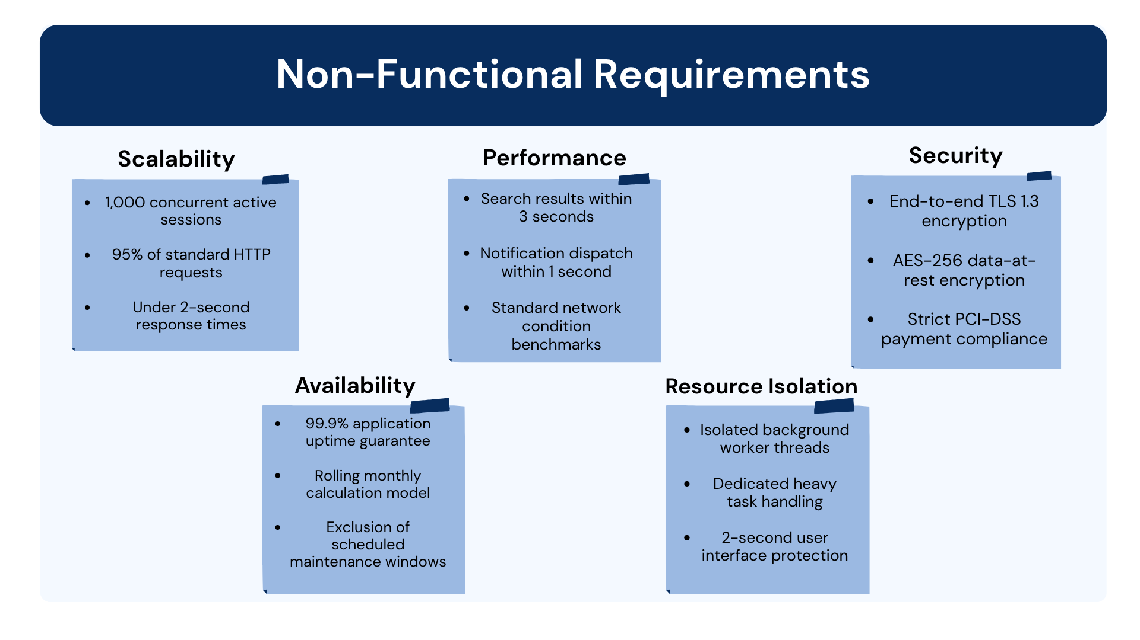

Slide 8
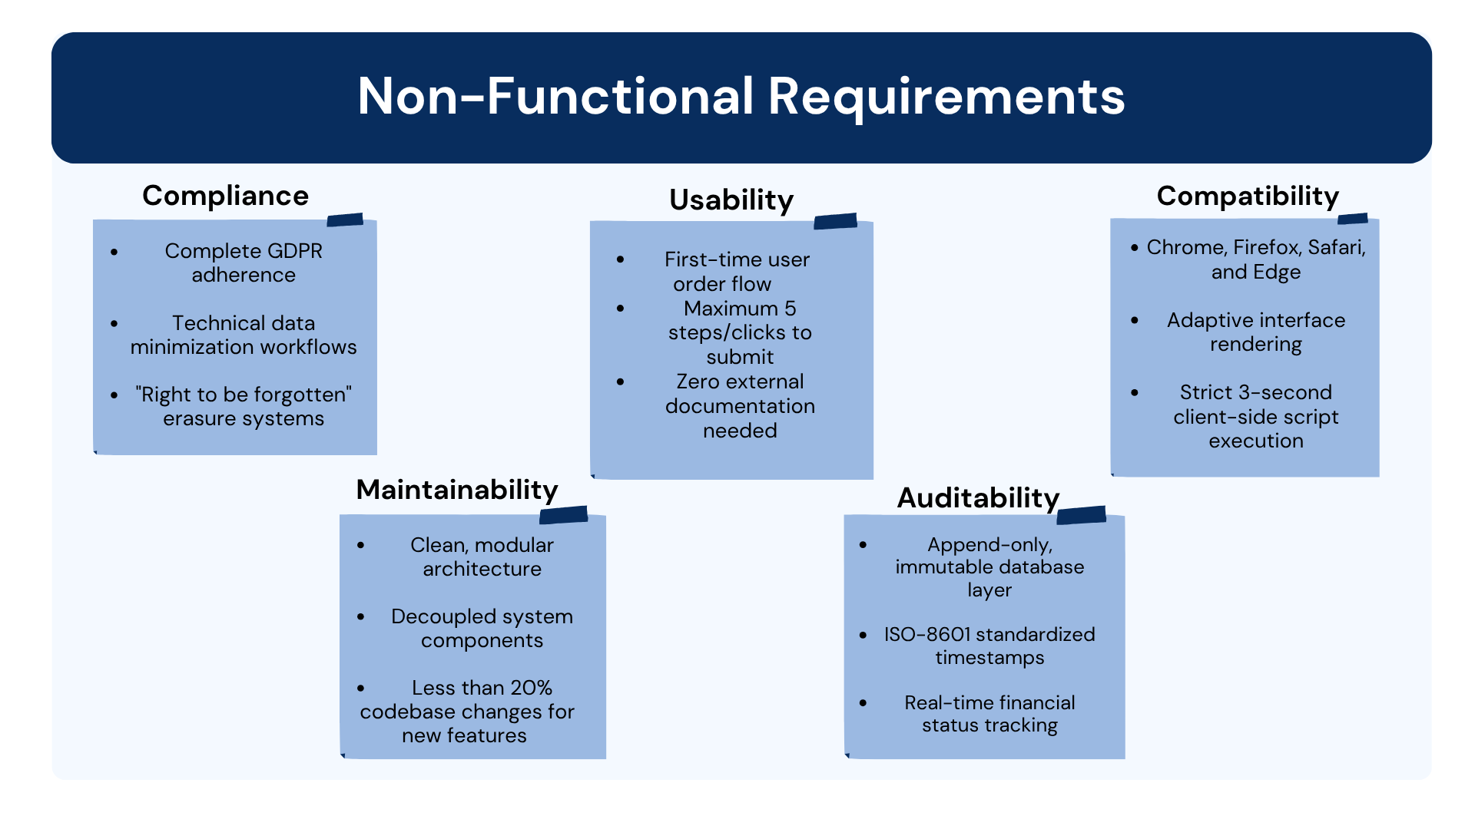

Slide 9
SELECTED TOOLS
BES(T)POKE
01
02
DEPLOYMENT
AI DETECTION
AWS
Google Vision
SOFTWARE TOOLS SELECTION
03
04
FRONTEND
BACKEND
React.js
.NET Core
05
06
DATABASE
PAYMENT
MS SQL Server
Iyzico

Slide 10
BES(T)POKE | Software Tools Selection
1 / 3
DEPLOYMENT PLATFORM
PAYMENT / ESCROW
AWS
Iyzico
Cost Score
18.8
Cost Score
0.0
Training Score
41.7
Training Score
25.0
Functionality Score
100.0
Functionality Score
100.0
TOTAL
160.5
TOTAL
125.0
Why AWS?
Why Iyzico?
Most reliable cloud platform worldwide. Full stack: Compute, Storage, CDN, SQS. Supports .NET + SQL Server (RDS) with minimal integration risk.
Fully compatible with Turkish market regulations. Supports escrow-style transactions. Funds held until approval or 72h timeout.

Slide 11
BES(T)POKE | Software Tools Selection
2 / 3
FRONTEND FRAMEWORK
BACKEND FRAMEWORK
React.js
.NET Core
Cost Score
100.0
Cost Score
100.0
Training Score
58.3
Training Score
58.3
Functionality Score
100.0
Functionality Score
100.0
TOTAL
258.3
TOTAL
258.3
Why React.js?
Why .NET Core?
Large ecosystem with ready-to-use components. Speeds up development for dynamic marketplace screens significantly.
LINQ feature automatically prevents SQL Injection. Highest functionality (98/100). Critical security for financial transactions.

Slide 12
BES(T)POKE | Software Tools Selection
3 / 3
DATABASE
MS SQL Server
Cost Score
68.2
Training Score
66.7
Functionality Score
96.9
TOTAL
231.8
Why MS SQL Server?
Native compatibility with .NET & C#. Entity Framework makes DB operations faster and more secure. Essential for Escrow data integrity.

Slide 13
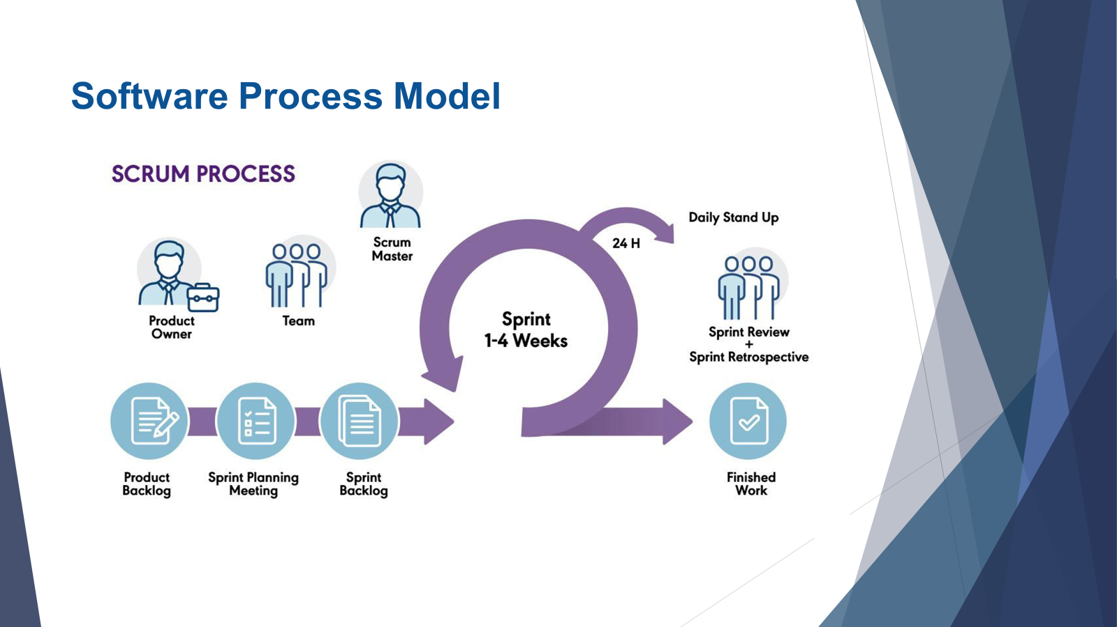

Slide 14
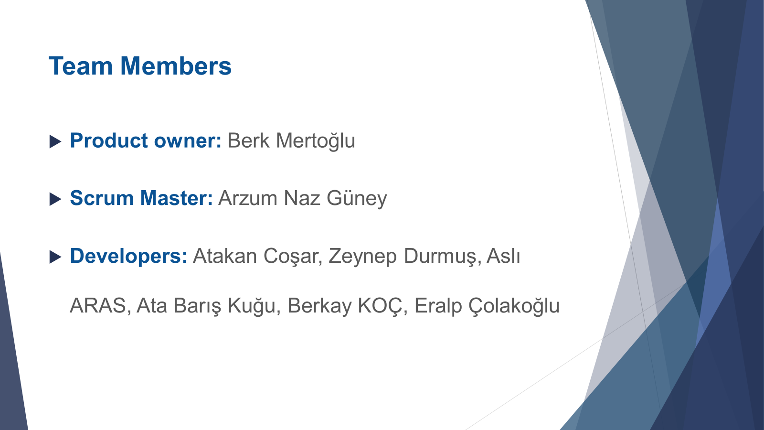

Slide 15

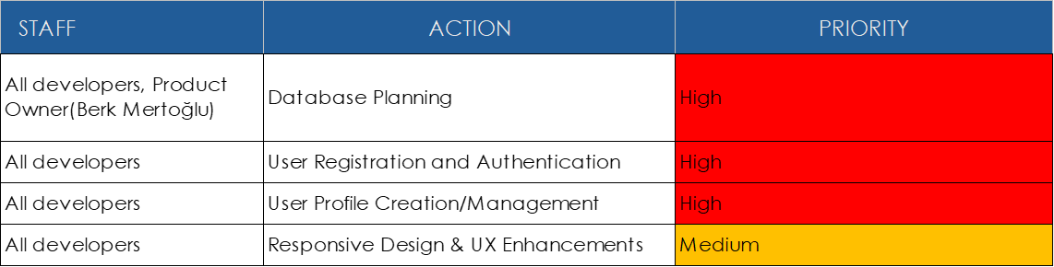
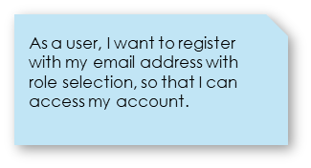
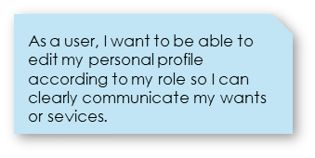
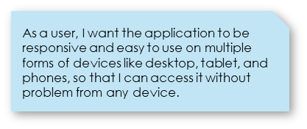
SPRINT-1

Slide 16
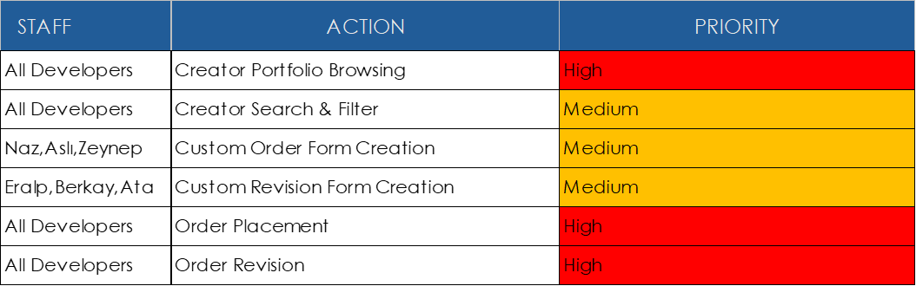
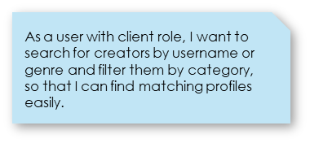
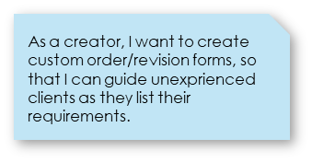
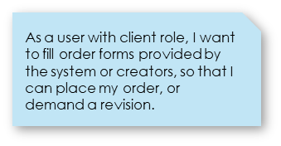
SPRINT-2

Slide 17
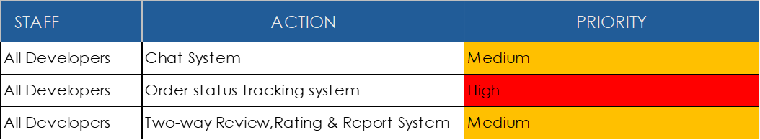
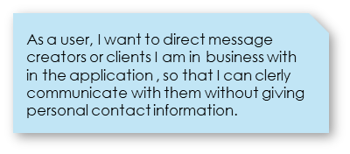
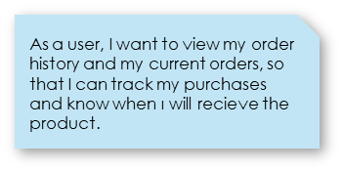
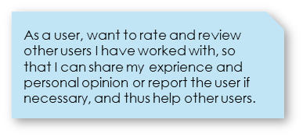
SPRINT-3

Slide 18
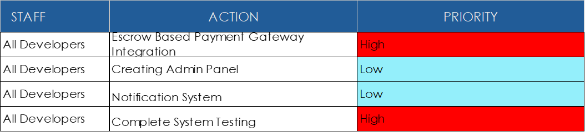
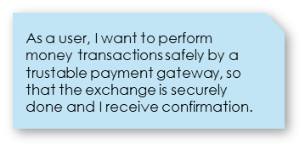
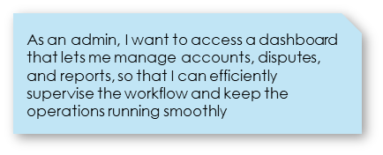
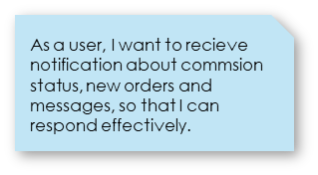
SPRINT-4

Slide 19
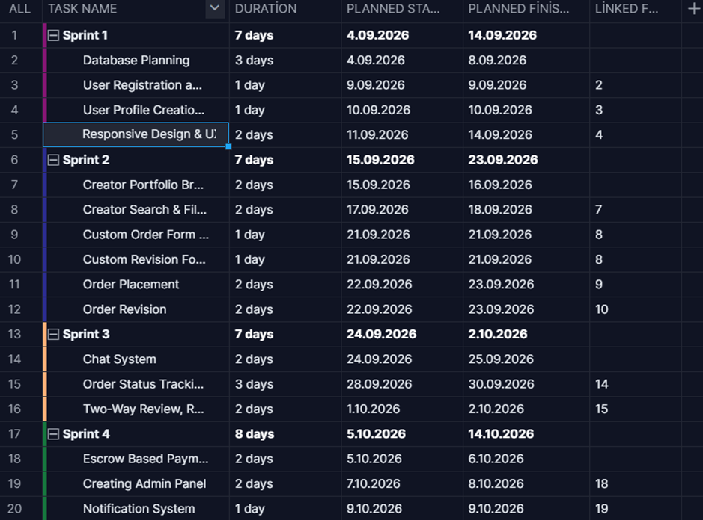
Schedule Overview
Sprint-Based Planning
The project is divided into four main sprints.
Each sprint focuses on a specific system feature.
This structure helps organize tasks more clearly.
Work is completed step by step.
Sprint planning helps track progress and deadlines.

Slide 20
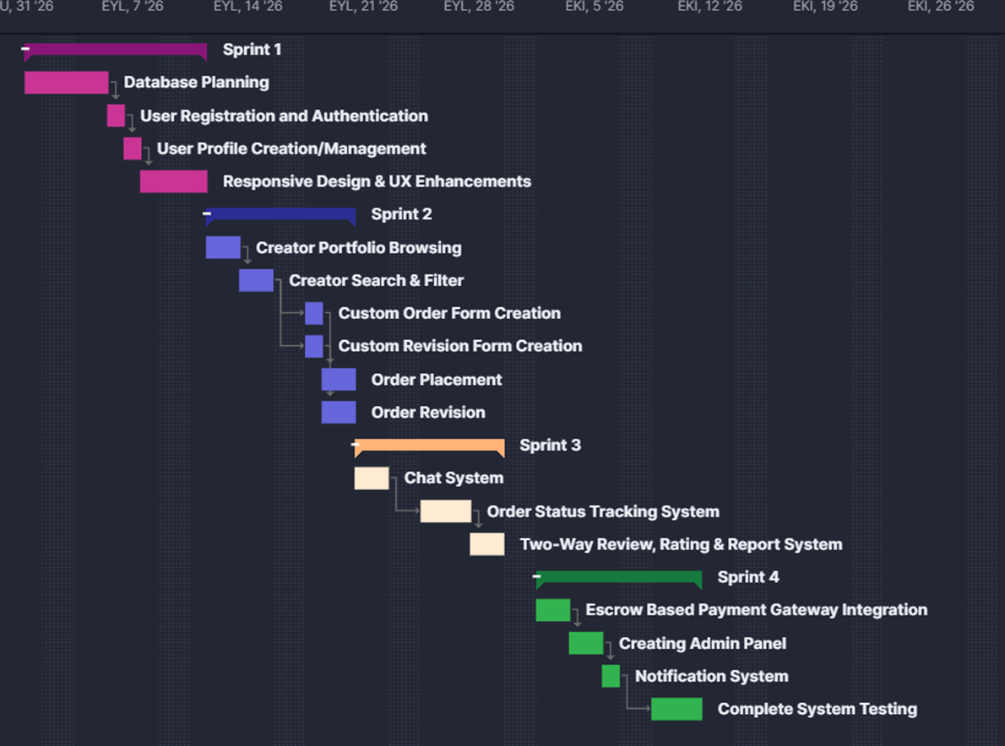
Gantt Chart Overview
What We Planned
Sprint 1: Basic system setup and user features
Sprint 2: Creator and order-related features
Sprint 3: Communication and tracking features
Sprint 4: Payment, admin panel, notifications, and testing

Slide 21
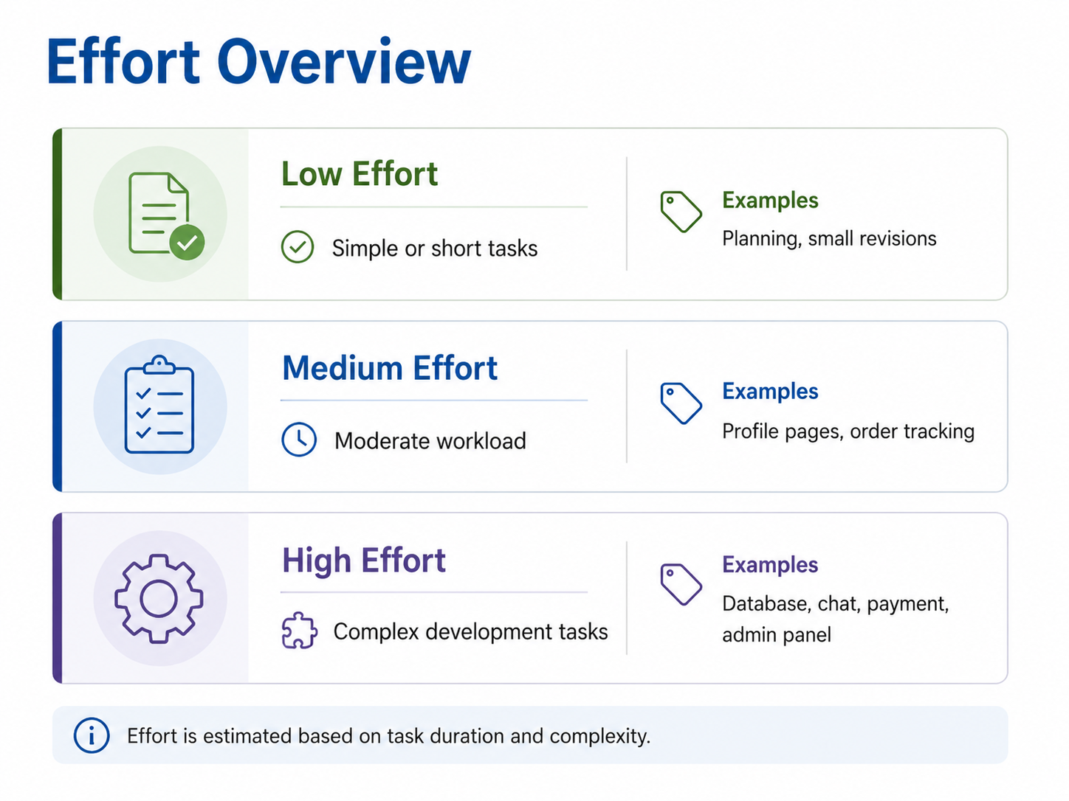
Key Point
High-effort tasks require more time, testing, and coordination, so we planned them carefully in the schedule.

Slide 22
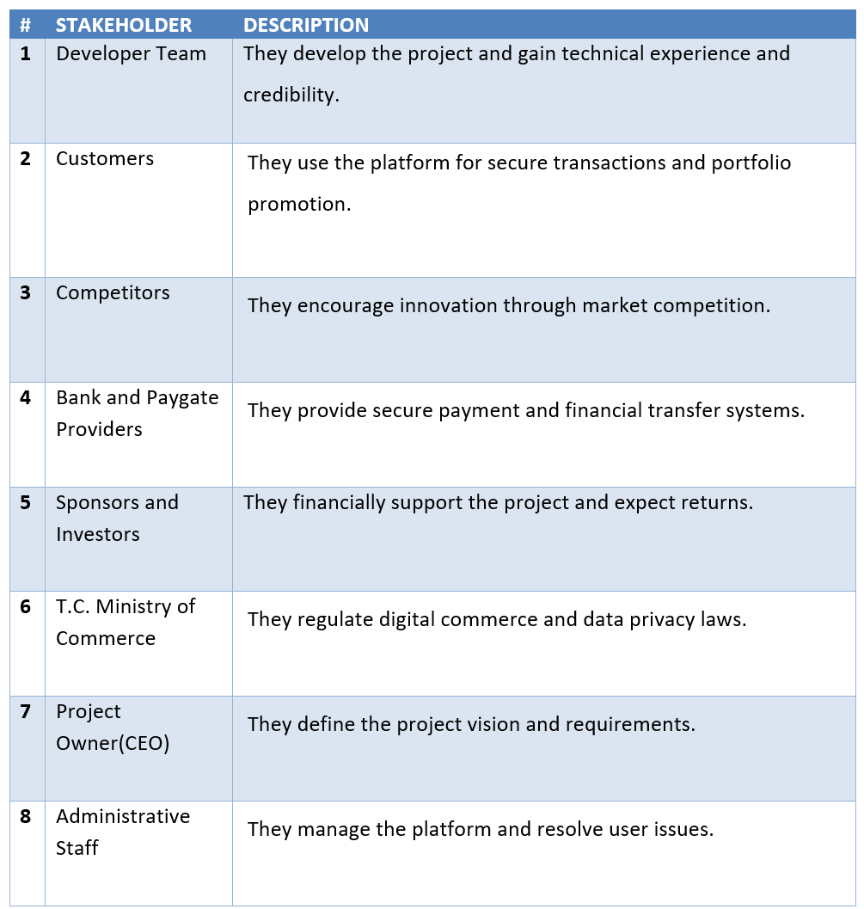
Stakeholders

Slide 23
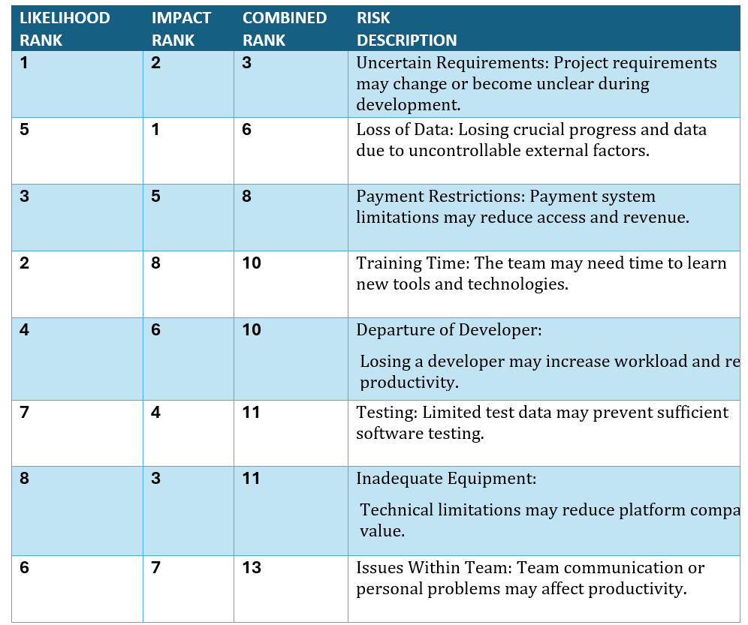
Project Risks

Slide 24
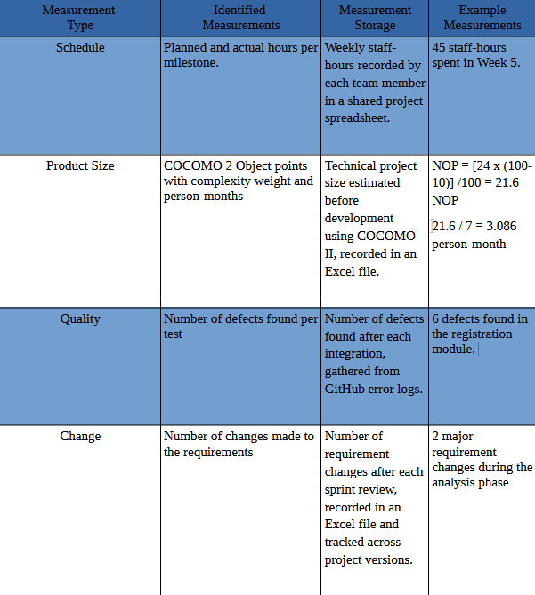
Measurements

Slide 25
Graphical User Interfaces
Customer Ui’s:
Creator Ui’s:
Admin Ui’s:
https://drive.google.com/file/d/15-dZuYz70U59DGmRGAgalx-exm4HrmLC/view?usp=sharing
https://drive.google.com/file/d/1jQkcQXuL3_kq13dxdbwHJzc3IzWR-Hba/view?usp=sharing
https://drive.google.com/file/d/18KDA4QW0wVYuwI2J47-VElz3DhTBeVEF/view?usp=sharing

Slide 26
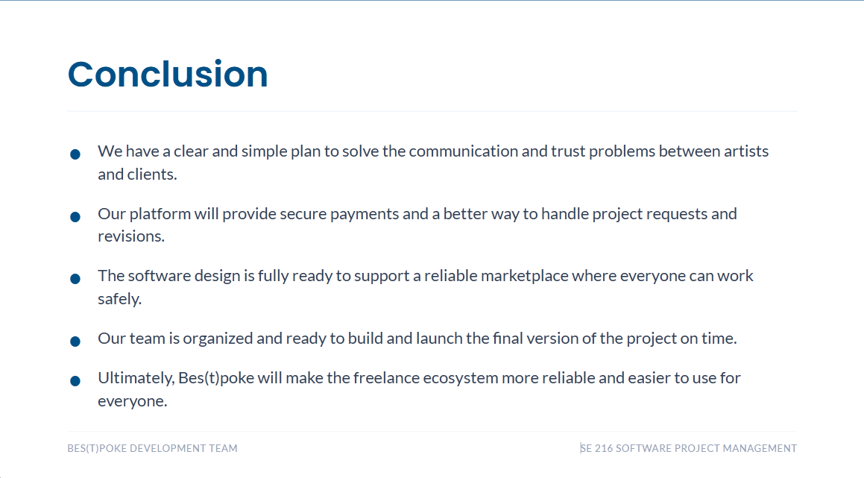

Slide 27
References

